Slide 1


Slide 2


Slide 3


Slide 4
Sorry!
The app that you were running crashed.
Close to return to Windos.
An error report has been sent to Micr0$0ft.

Slide 5
Access denied!
You have no permission to access this!
Windos XP is doing this for the sake of Windos XP.
Do you want to destroy this OS?
Wait, what?
No way I will let you destroy Windos XP!

Slide 6
EXE file error
This EXE file cannot be opened.
It does not have a valid GUI.
Please close the widow to return to the desktop.

Slide 8
CMD:
\User\data\CMD\cmd.exe>

Slide 9
Explorer

Slide 10
EDGE site***
Home***about***help***quit

Slide 12




















All legacy icons

Slide 13



































































All icons

Slide 14





All icons from the essentials pack***Made by Smashicons on flaticon.com

Slide 15
All icons from the interface pack***Made by Chanut on flaticon.com

Slide 16
All icons from the adobe logos pack***Made by Chanut on flaticon.com

Slide 17

All icons from Power User***Made by Power User

Slide 18


Slide 19
What’s new in this version:
Now in beta!
Updated SE0.99 to WSE v1.00
Added app crash screen
Updated EDGE to v1.02
Updated fonts
Added icons from power user!
Added run and Winver
added CMD v0.50
Added Web Hacker v1.00
Windos XP beta 1
This version of Windos is not genuine
Unstable OS build
start

Slide 20
Administrator***standard user***Users
Welcome to Windos XP!
Explorer
Control Panel
All Apps
Run…
Web browser
EDGE 1
Email client
none
Windos Security Essentials
start

Slide 21
All apps
Explorer
EDGE
WSE v1.00

Slide 22
EDGE 1
Registered to:
Username
Company
V1. 02

Slide 23
EDGE v1.02***stable browser***unstable OS build
Welcome to the Internet, Administrator!
Click on a link to go to the corresponding website:
Google
Bing
Ask Jeeves
Windos official
Version Plan XP
EDGE insider
Google Krom
Welcome to EDGE, IE’s replacement. Click on an underlined piece of text to go to that website!
Home***about***help***quit

Slide 24
Windos help utility
V1.01
For Windos XP

Slide 25
Help error
Help cannot find windos.hlp in \Windos\system\
Please update and try again.

Slide 26
Explorer
\

Slide 27
Explorer
\
User
ALLAPPS
Windos

Slide 28
Explorer
\Windos
system32
Windos.exe
icon

Slide 29
Explorer
\Windos\icons
current.dll
ess1.dll
Legacy.dll
interface.dll
adobe.dll

Slide 30
EDGE site***Windos XP Official Site
Become an insider and get a free copy when it comes out!
>get Windos XP alpha <blocked by site>
>discover Windos XP <invalid URL>
>features <invalid URL>
>security standards <invalid URL>
>become an Insider <invalid URL>
>Windos 2000 <invalid URL>
>Windos Vista <invalid URL>
Discover Windos XP, the next version of Windos!
EDGE tells you if a link is invalid so you can save time!
start
Windos XP alpha
Home***about***help***quit

Slide 31
EDGE site***XP version plan
Version plan:
Beta 1 is the Internet Update
beta 2 App Update
Beta 3 Security update 1
Beta 4- help update
Beta 5- final beta update
V1. 00 launch update
V1. 01 new tech
V1. 02 new tech + features
V1. 03 new features
SP1
SP2
SP3
V1.04 final update
V1. 05 discontinuation update
Home***about***help***quit

Slide 32
Windos Security Essentials v1.00
Security essentials for Windos 2000 SP2 and XP V1. 00
Antivirus ON
Ransom Protect
Firewall
VPN
Internet Blocker ON

Slide 33
Scanning for malware…

Slide 34
Results:
NaN

Slide 35
Internet Blocker 1.0
Internet Blocker is the replacement for the age old Web Protection standard.
This blocker uses advanced tech to detect if a suite is a scam, virus, or PUP and does NOT let you through.
It is enabled by default and even blocks fake ads!

Slide 36
System summary:
beta OS installed
Internet Blocker 1.0 ON
Antivirus ON
Firewall OFF
VPN OFF
Ransom Protect OFF
Legacy BIOS 2 ON
WP3 ON

Slide 37
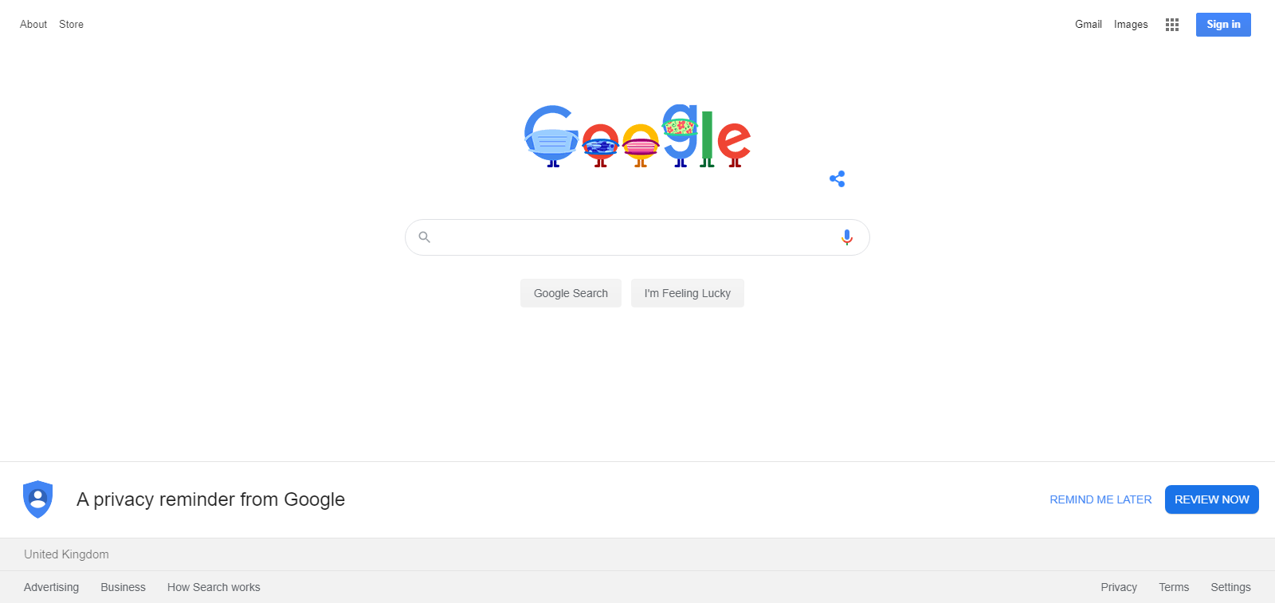
EDGE site***Google as of 5/8/2020
Home***about***help***quit

Slide 38

EDGE site***Bing as of 5/8/2020
Home***about***help***quit

Slide 39

EDGE site***Ask Jeeves
Home***about***help***quit

Slide 40
Run. ..
Winver
OK
Cancel
Help

Slide 41
About Windos
Micr0$0ft Windos XP
Beta –
2020 Micr0$0ft c0rp
Registered to:
Administrator
Company

Slide 42
EDGE site***EDGE insider
Download EDGE beta and test features out!
>Data-insert
>browser=kromv42
>AdBlock=false
>OS=win2k v1.00
>region=UK
>date=5/8/2020
>apply-all
>close
>keep-settings-1
>login admin pass
LOGIN INCORRECT
>exit
>hack edgeinsider.com login
Enter username
>admin
Searching. ..
Found user admin
Password=password
>login admin password
Logged in
>plugin-AdBlock=on
AdBlock is on
>exit
>set <site> EDGE Insider
>exit
>quit
Info:
Krom 42
UK
Username: Admin
download
Home***about***help***quit

Slide 43
EDGE Insider preview
V1. 00
Registered to insider:
Admin
Password

Slide 44
EDGE insider v1.02***stable OS****unstable browser***username= admin
Select a web page to view:
Google
Bing
Ask Jeeves
Windos official
Version Plan XP
EDGE insider is for testing purposes only!
Home***about***CMD***help***CMD v2***Hacker***exit

Slide 45
CMD v0.50
\User\data\CMD\cmd.exe>
Website Hacker
Winver

Slide 46
[ADMIN] CMD: Web Hacker v1.00***home
\Windos\system32\.hacks\web-hack\webhack.bat>
Google
Bing
Google Krom [console fitted in]
EDGE Insider [console fitted in]
Windos Official Site

Slide 47
CMD: hack google.com
>google.com
Connected to host google.com
>login admin password
Username non existent
>net user create admin
1.Admin
2.User
3.Premium user
>>1
Adding. ..
Error access denied
>hack login type=admin
Searching. ..found 223 admins.
>phish login type=admin no=1
U: Akinator
P: iamtoohard2beat
>login Akinator iamtoohard2beat
Logged in as Akinator.
>retrieve server data #private #project-x #top-secret #ceo
Retrieving data…
Save to?
>>\hacks\google
Saved.
>Sell \hacks\google
Sell to?
>haxorz.com
Searching. ..login needed
>disconnect
Enter URL!
>haxorz.com
Connected to host haxorz.com
>login Kevin-Mitnick AltaVista
Login success!
>sell \hacks\Google
Sell for?
$100,000
Put on sale.
>disconnect
>quit

Slide 48
CMD: bing.com
>bing.com
Connected
>login user pass
Login unavailable
>session 2
>microsoft.com
Connected
>session 1
>login user pass @session2
User invalid
>session 3
>haxorz.com
Connected
>search [Microsoft admin login]
Found Microsoft Admin Login 2020. product no. 1234567
>buy 1234567
Price is $100. accept?
>>yes
Bought. Username Adminz password Killer
>session 1
>login Adminz Killer
Logged in.
>phish #secret
Searching. ..
Save 25Tb to?
>\hacks\Bing
Saving. ..
Error. Firewall stopped transfer
>admin command
>>>firewall status
25 firewalls active
>>>disable firewall 25
22 disabled. 4 remain
>>>exit
>attack firewall 4
Attack complete
>reattempt-dl
Downloading. ..
>session 3
>sell \hacks\Bing $100,000
Sold.
>exit

Slide 49

EDGE site***Google Krom
>data set
On
>browser=edge v1.00
>region=UK
>AdBlock=false
Apply=all
>close
Off.
>hack now
Hacking. .. Stored on\hacks\Krom
>haxorz.com login auto
OK
>sell \hacks\Krom $250,000
Sold.
>stop console
-------Console stopped------
EDGE sucks,
Get Krom!
Download button below:
Get Krom For Free!
Home***about***help***quit

